Slide 1

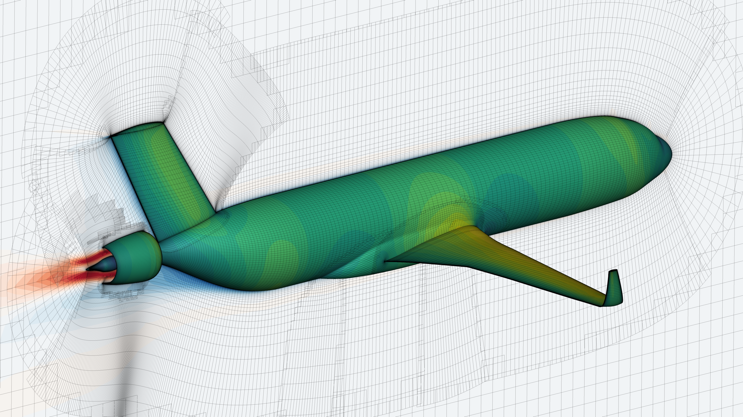
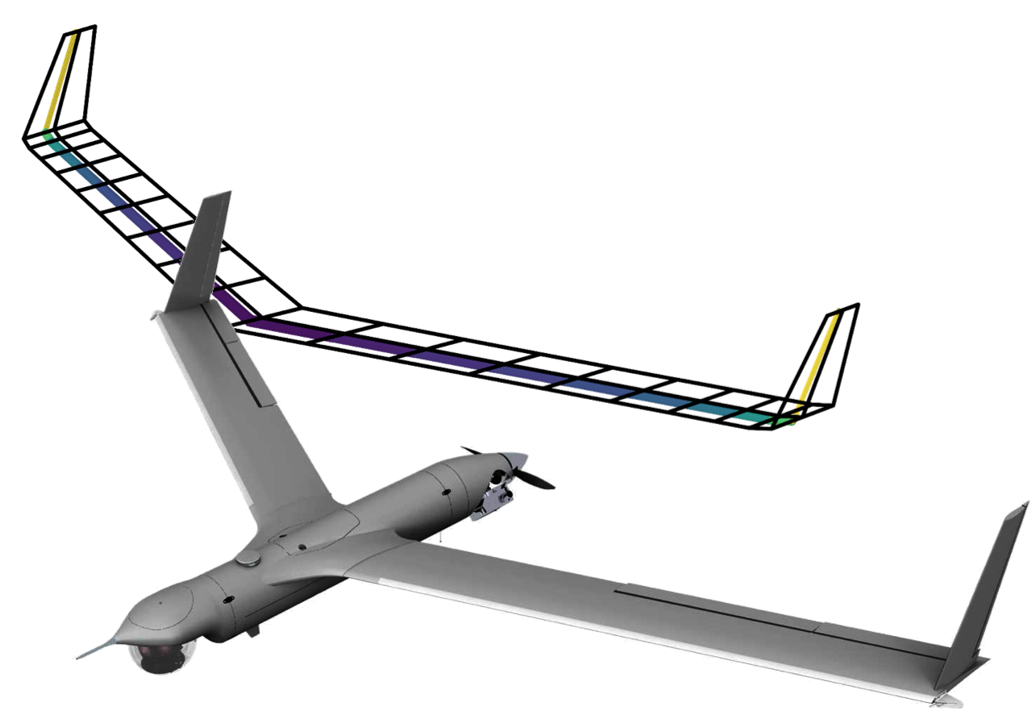
Getting derivatives in
John Jasa johnjasa@umich.edu
University of Michigan MDO Lab
Justin Gray justin.s.gray@nasa.gov
NASA Glenn Research Center

Slide 2
This sessions assumes some baseline knowledge
You’ve used OpenMDAO models before
You understand when gradient-based optimization methods are advantageous
You have a working understanding of how to get derivatives of math expressions

Slide 3
Download these slides and tutorial scripts from GitHub
https://github.com/openmdao/openmdao_training
Our materials for today are in the `getting_derivatives_in_openmdao` folder
This repo contains other tutorials to help you get acquainted with OpenMDAO

Slide 4
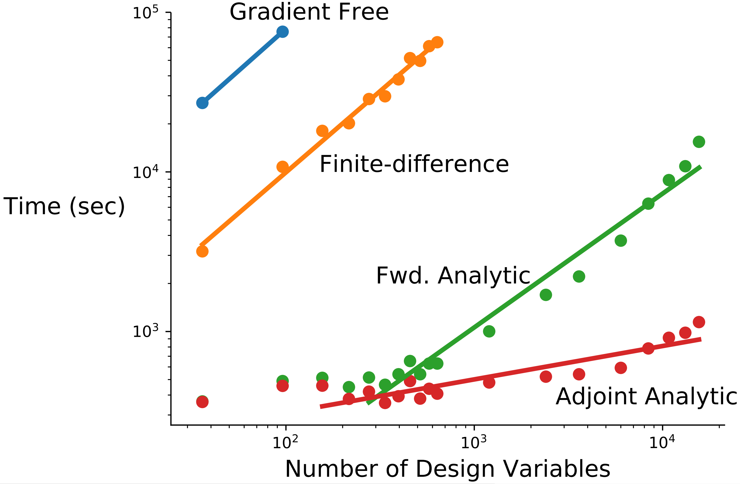
Gradient-based optimization with analytic derivatives is our only hope for large-scale problems
100x-10,000x speedup for aerodynamic shape optimization vs. gradient-free¹
At least 5x-10x speedup vs. finite-difference²
[1] Lyu et al. ICCFD8-2014-0203
[2] Gray et al. Aviation 2014-2042

Slide 5
Goals for today
Understand how to obtain partial derivatives
Know the differences between explicit and implicit components and what that means for partials
Briefly learn about some advanced techniques to obtain partial derivatives

Slide 6
Brief introduction to how OpenMDAO handles derivatives
Why do we need derivatives?
How does OpenMDAO process these derivatives?
How can we efficiently obtain these derivatives?

Slide 7
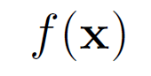
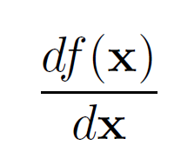
Optimization
OpenMDAO is capable of evaluating DOEs just like ModelCenter, but…
Gradient based optimization is A LOT faster!
So we need total derivatives across the whole model:
??

Slide 8
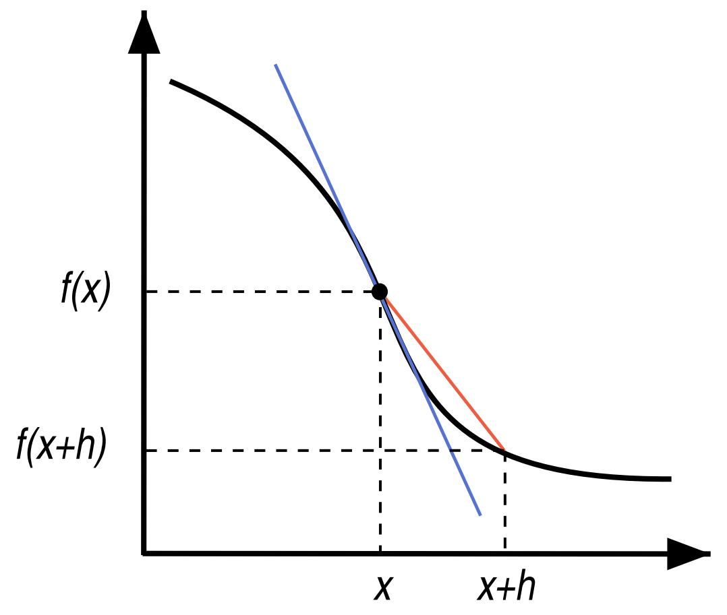
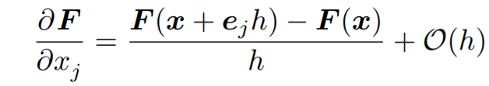
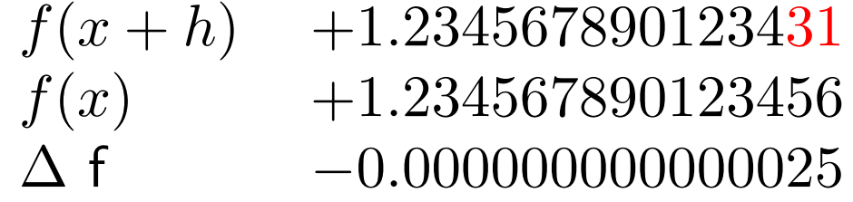
Finite difference is easy

Slide 9
Finite difference is easy, but…
Treats your model as a black-box
Expensive
Accuracy can be bad, especially close to the optimal point

Slide 10
It’s not a good idea to finite difference across solvers
Seriously… don’t do this unless you really have to.
It’s expensive (make your solver tolerances really tight)
It’s inaccurate
It will probably make your optimization converge slowly!
Lots of papers on this topic:
E. S. Hendricks and J. S. Gray, “Pycycle: a tool for efficient optimization of gas turbine engine cycles,” Aerospace, vol. 6, iss. 87, 2019.
E. S. Hendricks, “A multi-level multi-design point approach for gas turbine cycle and turbine conceptual design,” PhD Thesis, 2017.
J. S. Gray, T. A. Hearn, K. T. Moore, J. Hwang, J. Martins, and A. Ning, “Automatic Evaluation of Multidisciplinary Derivatives Using a Graph-Based Problem Formulation in OpenMDAO,” in 15th AIAA/ISSMO Multidisciplinary Analysis and Optimization Conference, 2014.
J. S. Gray, K. T. Moore, T. A. Hearn, and B. A. Naylor, “Standard Platform for Benchmarking Multidisciplinary Design Analysis and Optimization Architectures,” AIAA Journal, vol. 51, iss. 10, p. 2380–2394, 2013.
C. Marriage and Martins, J. R. R. A. “Reconfigurable Semi-Analytic Sensitivity Methods and MDO Architectures Within the πMDO Framework”, in Proceedings of the 12th AIAA/ISSMO Multidisciplinary Analysis and Optimization Conference, Victoria, BC, 2008.

Slide 11
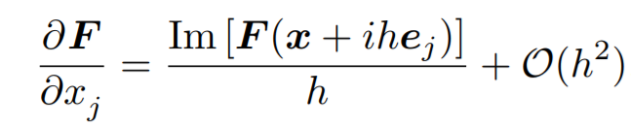
Complex step is more accurate than FD, but…
Treats your models as a gray-box (might require code modification)
Even more expensive
Some functions are tricky…
min(), max(), abs() can cause issues
[Martins et al., ACM TOMS, 2003]

Slide 12
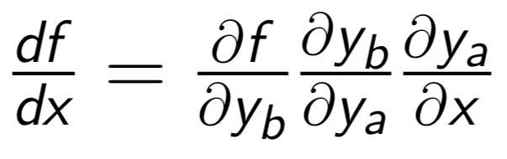
Analytic derivatives are both fast and accurate!

Slide 13
What about models with coupling?

Slide 14
How do you differentiate through this convergence loop?
We’ll need a nonlinear solver to converge this coupling.
The solver loop changes the way you compute analytic derivatives

Slide 15
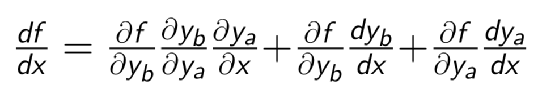
Manually computing analytic derivatives for coupled models takes a lot of work

Slide 16
How do compute these extra terms?
These terms will be computed using adjoints!

Slide 17
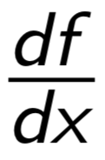
When models get really big … have fun!
= ???
Lets be honest, this just isn’t going to happen!

Slide 18
OpenMDAO can compute these total derivatives for you, automatically!
= [ask OpenMDAO]
For a deep dive on the math:
[Martins and Hwang 2013]
[Hwang and Martins 2018]

Slide 19
OpenMDAO splits total derivative computation into two steps
Computing the partial derivatives for each component
Solving a linear system for total derivatives

Slide 20
OpenMDAO splits total derivative computation into two steps
Computing the partial derivatives for each component
Numerical approach: FD/CS
Analytic approach: hand derivation or algorithmic differentiation
Mix and match numerical and analytic
You are responsible for this step, but OpenMDAO can help you a bit

Slide 21
OpenMDAO splits total derivative computation into two steps
1) Computing the partial derivatives for each component
2) Solving a linear system for total derivatives OpenMDAO does this automatically using a library of different linear solvers for different problems

Slide 22
By using OpenMDAO’s analytic derivative functionality you can
Efficiently solve optimization problems with 1000’s of design variables or thousands of constraints
Get total derivatives across a complicated model, by providing only partial derivatives of each component
Mix and match different techniques for computing partial derivatives

Slide 23
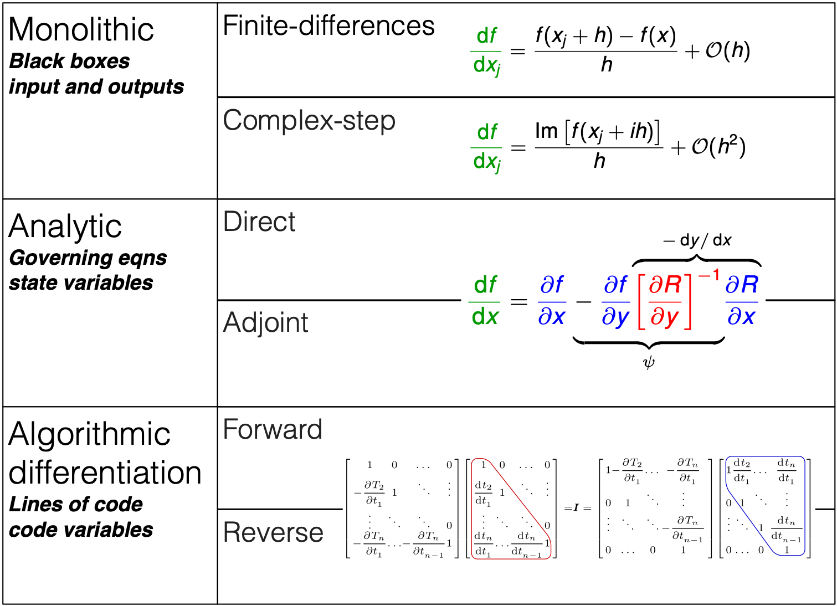
Methods for computing derivatives
[Martins et al., ACM TOMS, 2003]
[Martins and Hwang, AIAA Journal, 2013]
Notes:
Here is a quick overview of the different methods that are available.
Finite differences are popular, but suffer from accuracy problems. They are also not efficient, since they require at least one analysis for each design variable.
Only two of them scale well with the number of variables: adjoint methods, and reverse mode AD.

Slide 24
Computing partial derivatives of an ExplicitComponent
Hand-derived
Sparse hand-derived
Approximated (finite-difference or complex-step)

Slide 25
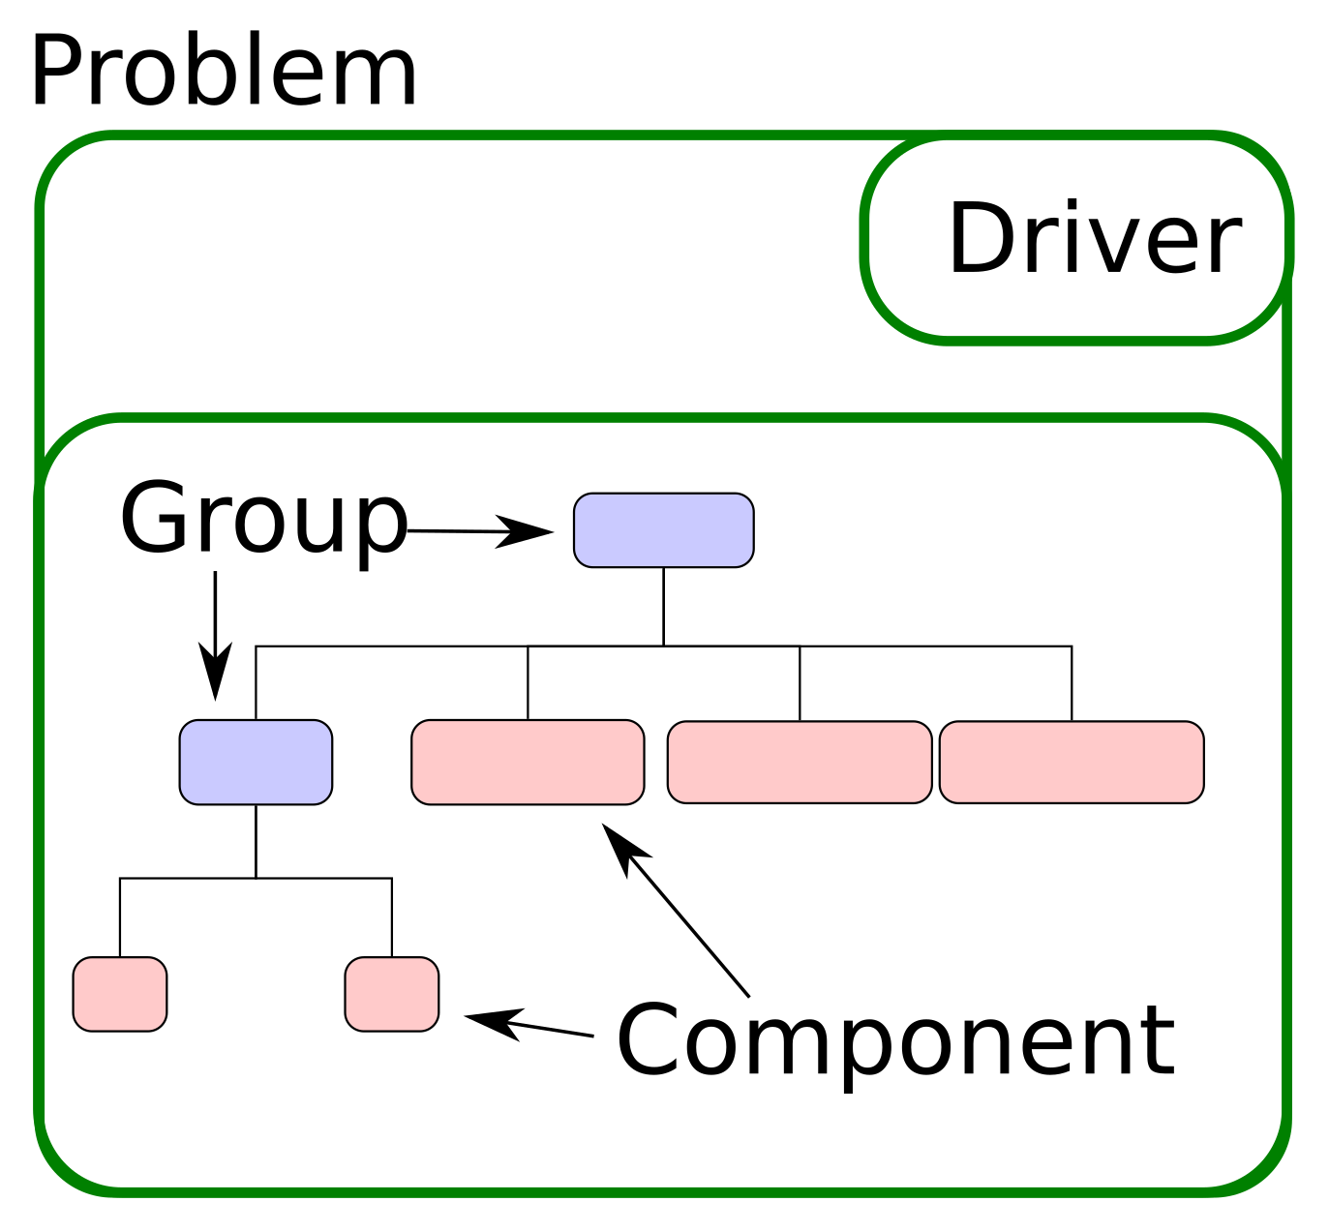
ExplicitComponent class
Used for doing explicit calculations
Inputs → Outputs
Can be as simple as a one-line calculation, or as complex as an adjoint CFD solver

Slide 26
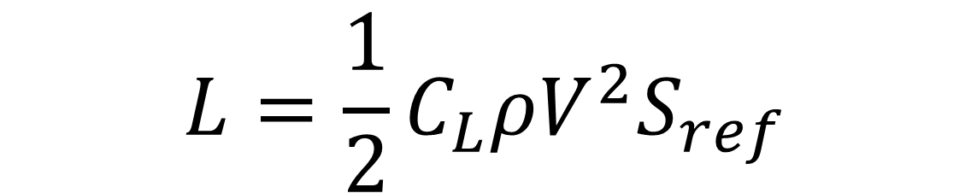
A simple ExplicitComponent example: Calculating lift from CL
$$L=\frac{1}{2}C_{L}ρV^{2}S_{ref}$$

Slide 27
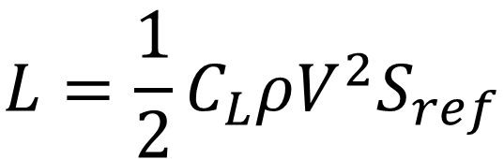
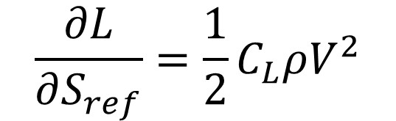
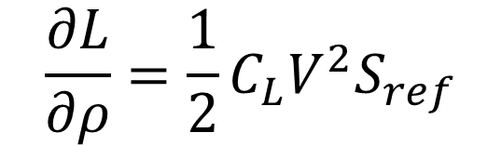
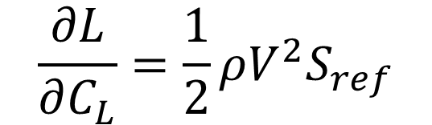
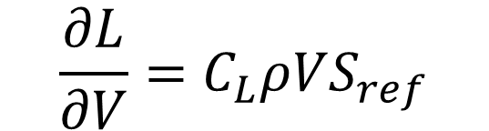
You could analytically compute the partials by hand
$$\frac{∂L}{∂V}=C_{L}ρVS_{ref}$$
$$\frac{∂L}{∂C_{L}}=\frac{1}{2}ρV^{2}S_{ref}$$
$$L=\frac{1}{2}C_{L}ρV^{2}S_{ref}$$
$$\frac{∂L}{∂ρ}=\frac{1}{2}C_{L}V^{2}S_{ref}$$
$$\frac{∂L}{∂S_{ref}}=\frac{1}{2}C_{L}ρV^{2}$$

Slide 28
OpenMDAO can approximate partial derivatives
Can use the finite-difference or complex-step methods to approximate the partials derivatives
This is generally more computationally expensive than analytic derivatives
It requires no additional programmer time

Slide 29
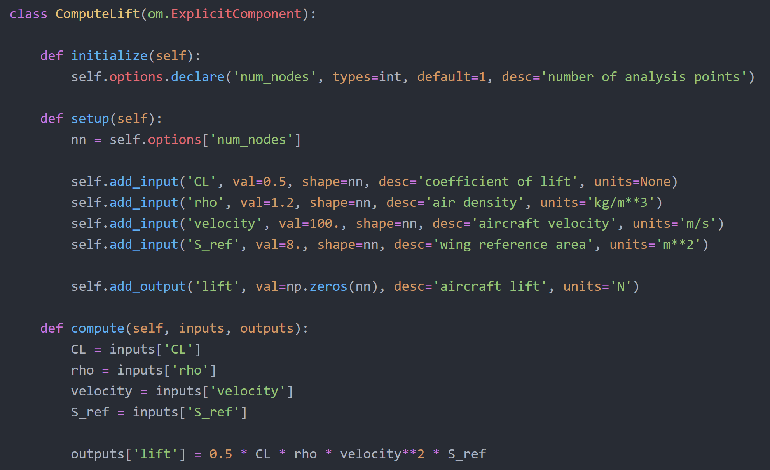

$$L=\frac{1}{2}C_{L}ρV^{2}S_{ref}$$

Slide 30
Explain Jacobian structure
Picture of square with diags filled in
Explain that it’s nominally an array

Slide 31
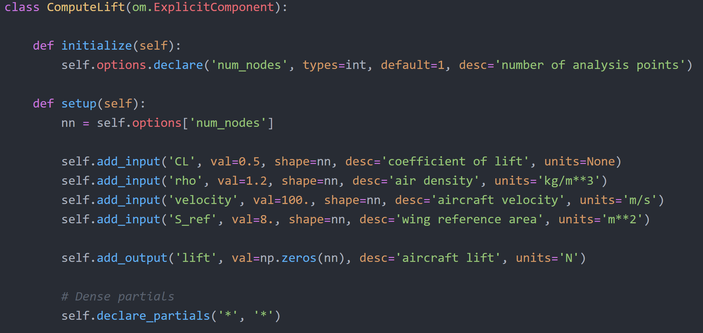
We tell OpenMDAO that all outputs depend on all inputs

Slide 32
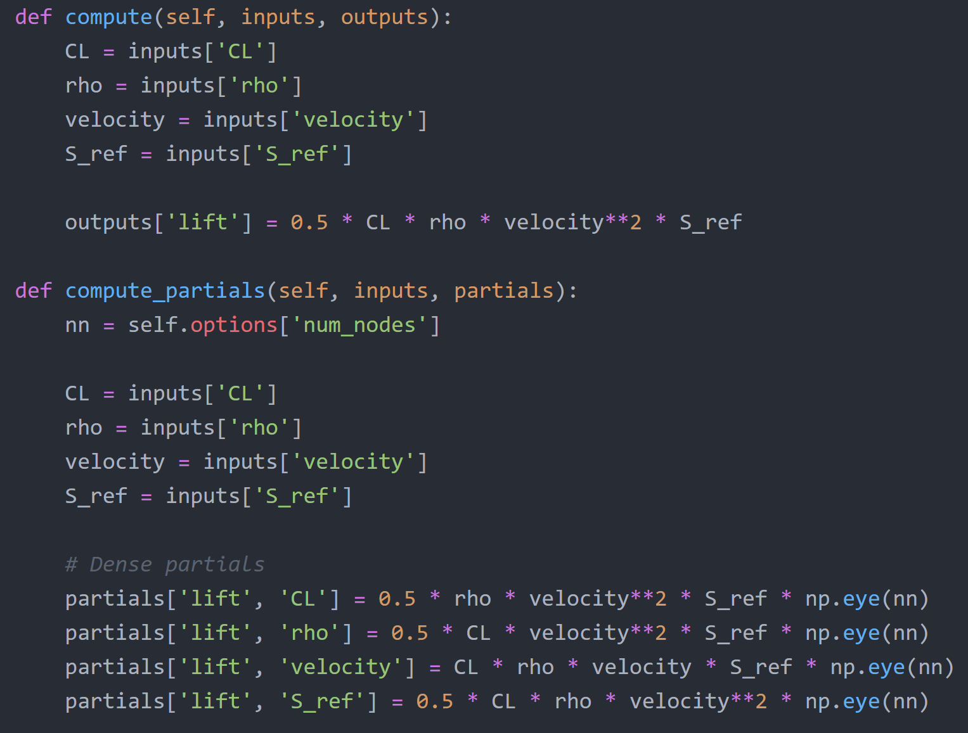
Give OpenMDAO the expressions for partial derivatives we computed before
Account for the shape of the Jacobian

Slide 33
check_partials output
------------------------- Component: ExecComp 'oew' ------------------------- '<output>' wrt '<variable>' | fwd mag. | check mag. | a(fwd-chk) | r(fwd-chk) ------------------------------------------------------------------------------- 'W_empty' wrt 'TOW' | 6.0000e-01 | 6.0000e-01 | 2.3842e-08 | 3.9736e-08 ------------------------------------ Component: BatteryWeight 'batterywt' ------------------------------------ '<output>' wrt '<variable>' | fwd mag. | check mag. | a(fwd-chk) | r(fwd-chk) ----------------------------------------------------------------------------------- 'W_battery' wrt 'LoverD' | 0.0000e+00 | 9.6353e+01 | 9.6353e+01 | 1.0000e+00 >ABS_TOL >REL_TOL 'W_battery' wrt 'TOW' | 0.0000e+00 | 3.2118e-01 | 3.2118e-01 | 1.0000e+00 >ABS_TOL >REL_TOL 'W_battery' wrt 'eta_electric' | 0.0000e+00 | 2.0946e+03 | 2.0946e+03 | 1.0000e+00 >ABS_TOL >REL_TOL 'W_battery' wrt 'eta_prop' | 0.0000e+00 | 2.3218e+03 | 2.3218e+03 | 1.0000e+00 >ABS_TOL >REL_TOL 'W_battery' wrt 'range_desired' | 0.0000e+00 | 1.2847e+01 | 1.2847e+01 | 1.0000e+00 >ABS_TOL >REL_TOL 'W_battery' wrt 'spec_energy' | 0.0000e+00 | 6.4235e+00 | 6.4235e+00 | 1.0000e+00 >ABS_TOL >REL_TOL ---------------------------- Component: WeightBuild 'tow' ---------------------------- '<output>' wrt '<variable>' | fwd mag. | check mag. | a(fwd-chk) | r(fwd-chk) ------------------------------------------------------------------------------- 'TOW' wrt 'W_battery' | 7.5000e+01 | 1.0000e+00 | 7.6000e+01 | 7.6000e+01 >ABS_TOL >REL_TOL 'TOW' wrt 'W_empty' | 7.5000e+01 | 1.0000e+00 | 7.6000e+01 | 7.6000e+01 >ABS_TOL >REL_TOL 'TOW' wrt 'W_payload' | 7.5000e+01 | 1.0000e+00 | 7.6000e+01 | 7.6000e+01 >ABS_TOL >REL_TOL ########################################################### Sub Jacobian with Largest Relative Error: WeightBuild 'tow' ########################################################### '<output>' wrt '<variable>' | fwd mag. | check mag. | a(fwd-chk) | r(fwd-chk) ------------------------------------------------------------------------------- 'TOW' wrt 'W_battery' | 7.5000e+01 | 1.0000e+00 | 7.6000e+01 | 7.6000e+01

Slide 34
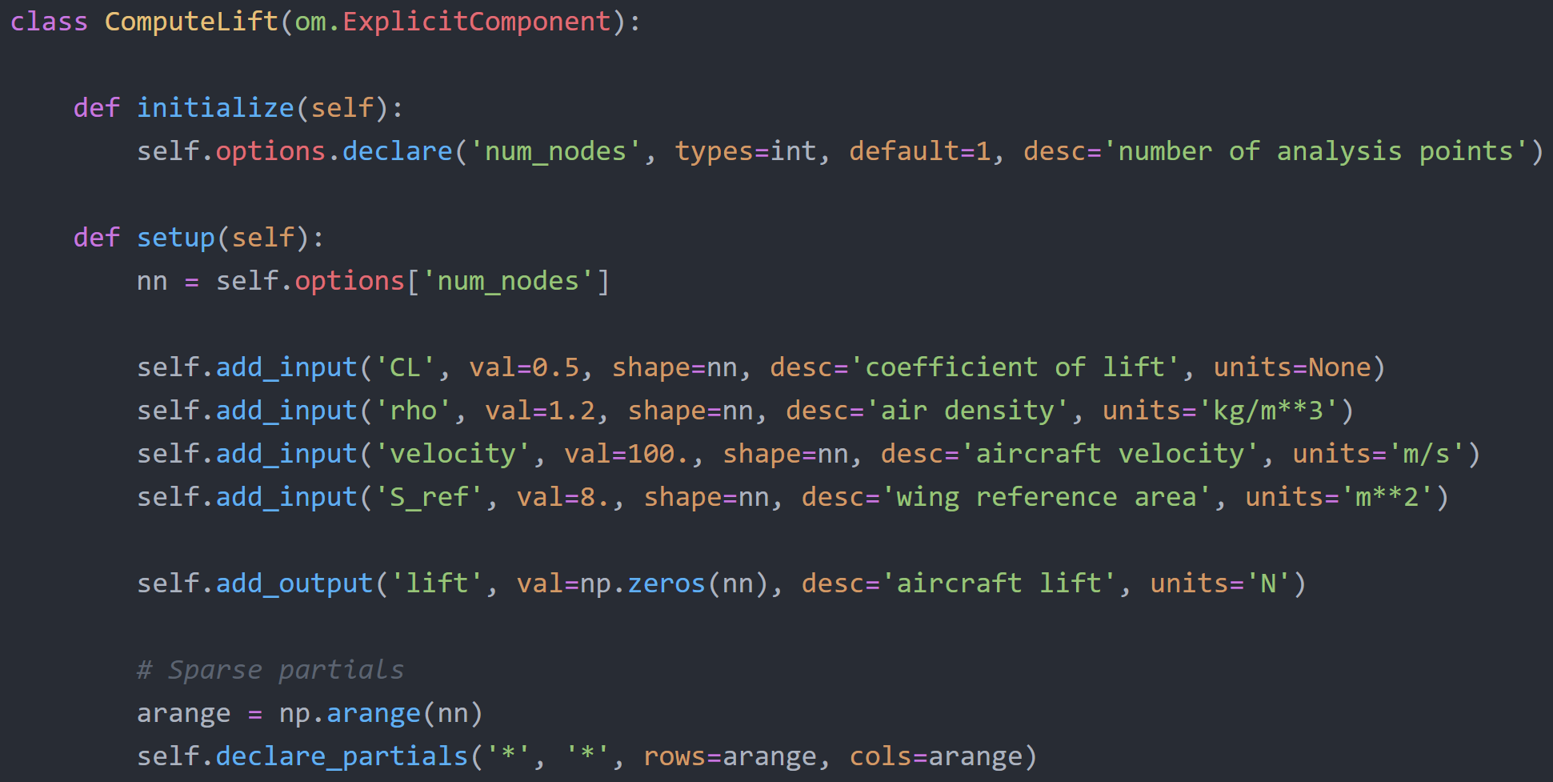
Tell OpenMDAO about the sparsity pattern of the Jacobian

Slide 35
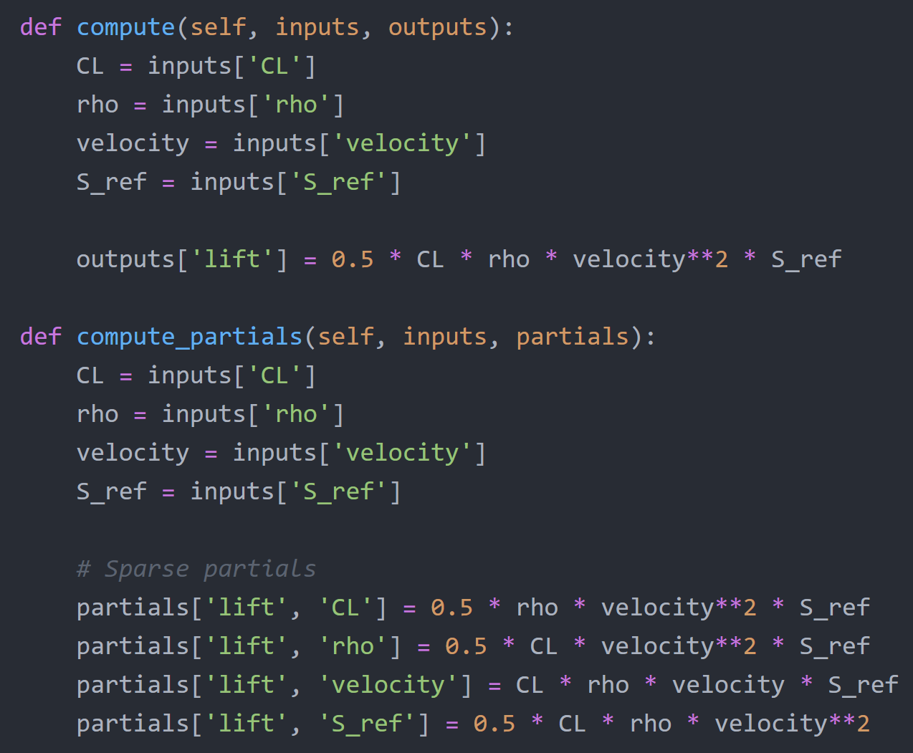
Now our expected partials shapes are vectors

Slide 36
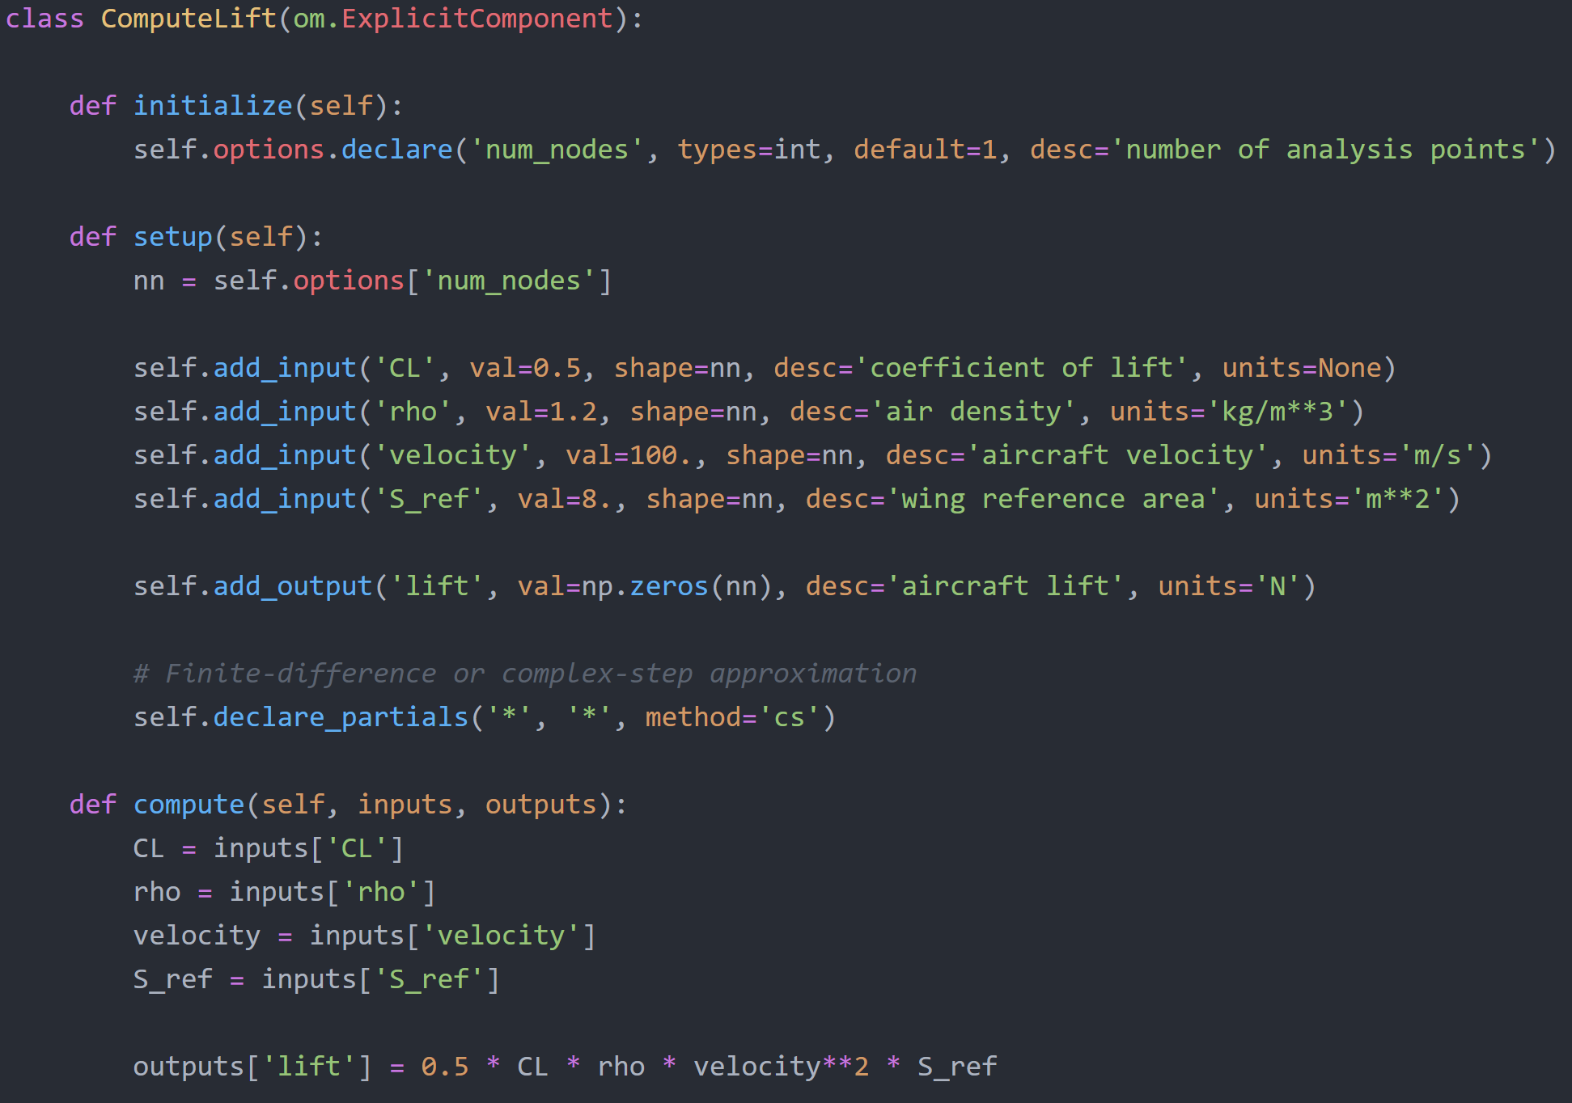
OpenMDAO can approximate derivatives automatically

Slide 37
Rules of thumb for computing partials
Fine to start out with FD partials while getting your model set up!
For cheap black-box codes:
FD might be ok for production runs
CS is better if you can do it!
For “expensive” codes (anything with an internal solver):
Implement as ImplicitComponent (expose the states/residuals to OpenMDAO)
Can still FD the residual if you need to
Analytic derivatives typically cost a lot for these components

Slide 38
Computing partial derivatives of an ImplicitComponent
Can use the same methods to obtain partials as explicit
Compute the partials of the residuals with respect to the inputs and outputs

Slide 39
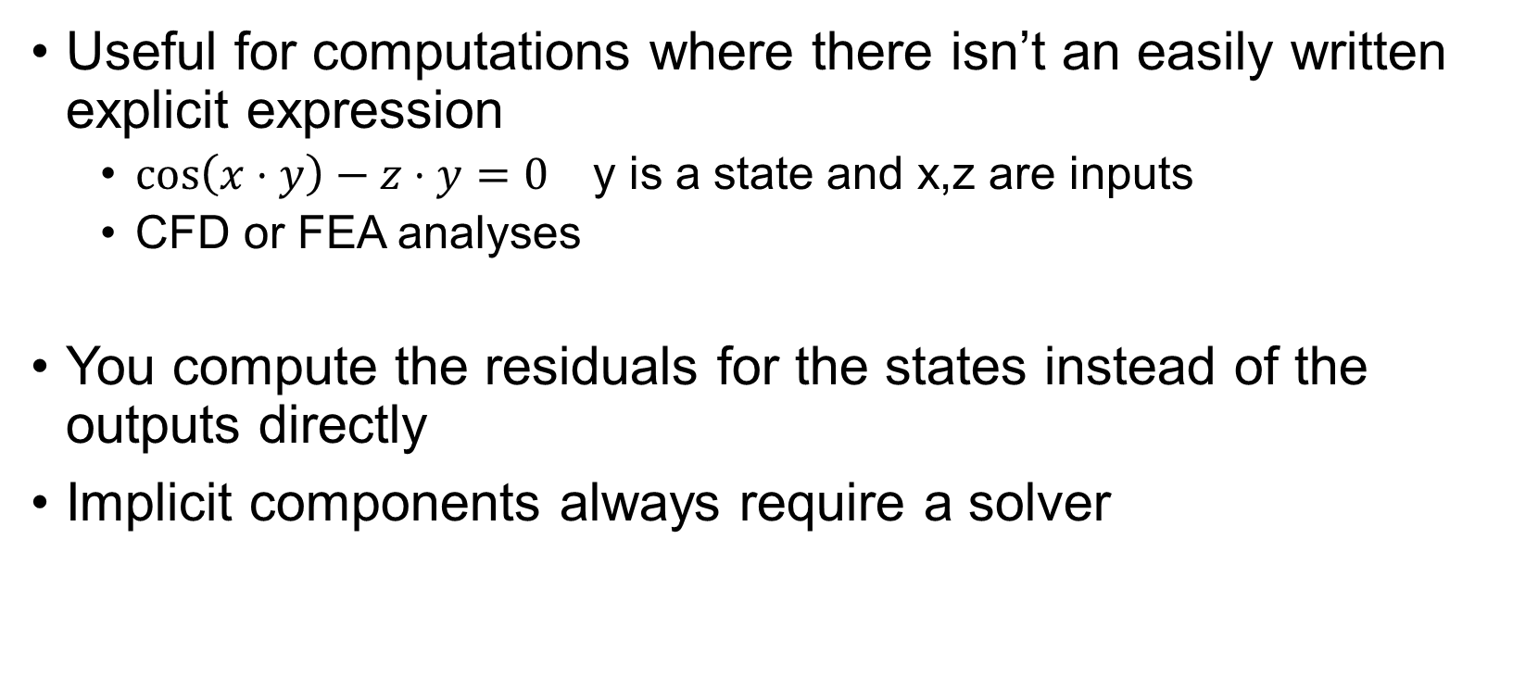
When do we need to use implicit components?
Useful for computations where there isn’t an easily written explicit expression
$\cos\left(x⋅y\right)−z⋅y=0$ y is a state and x,z are inputs
CFD or FEA analyses
You compute the residuals for the states instead of the outputs directly
Implicit components always require a solver
http://openmdao.org/twodocs/versions/latest/advanced_guide/implicit_comps/defining_icomps.html

Slide 40
Implicit components can use any of the derivative methods described previously

Slide 41
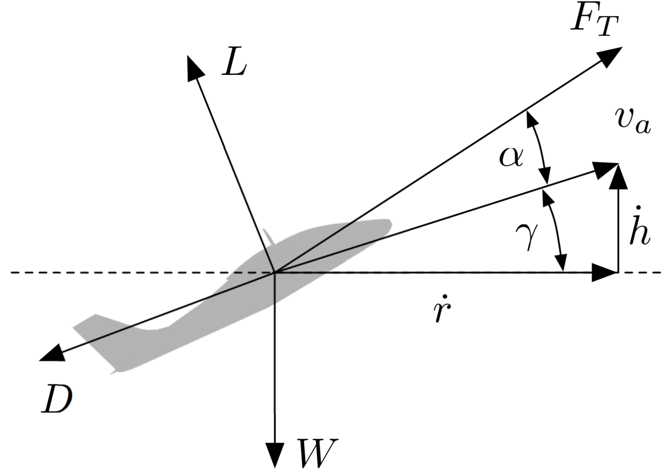
Example implicit component: Aircraft in flight equilibrium
$$F_{T}\cos\left(α\right)−D−W\sin\left(γ\right)=0$$
$$F_{T}\sin\left(α\right)+L−W\cos\left(γ\right)=0$$
[Falck et al., AIAA SciTech, 2017]

Slide 42
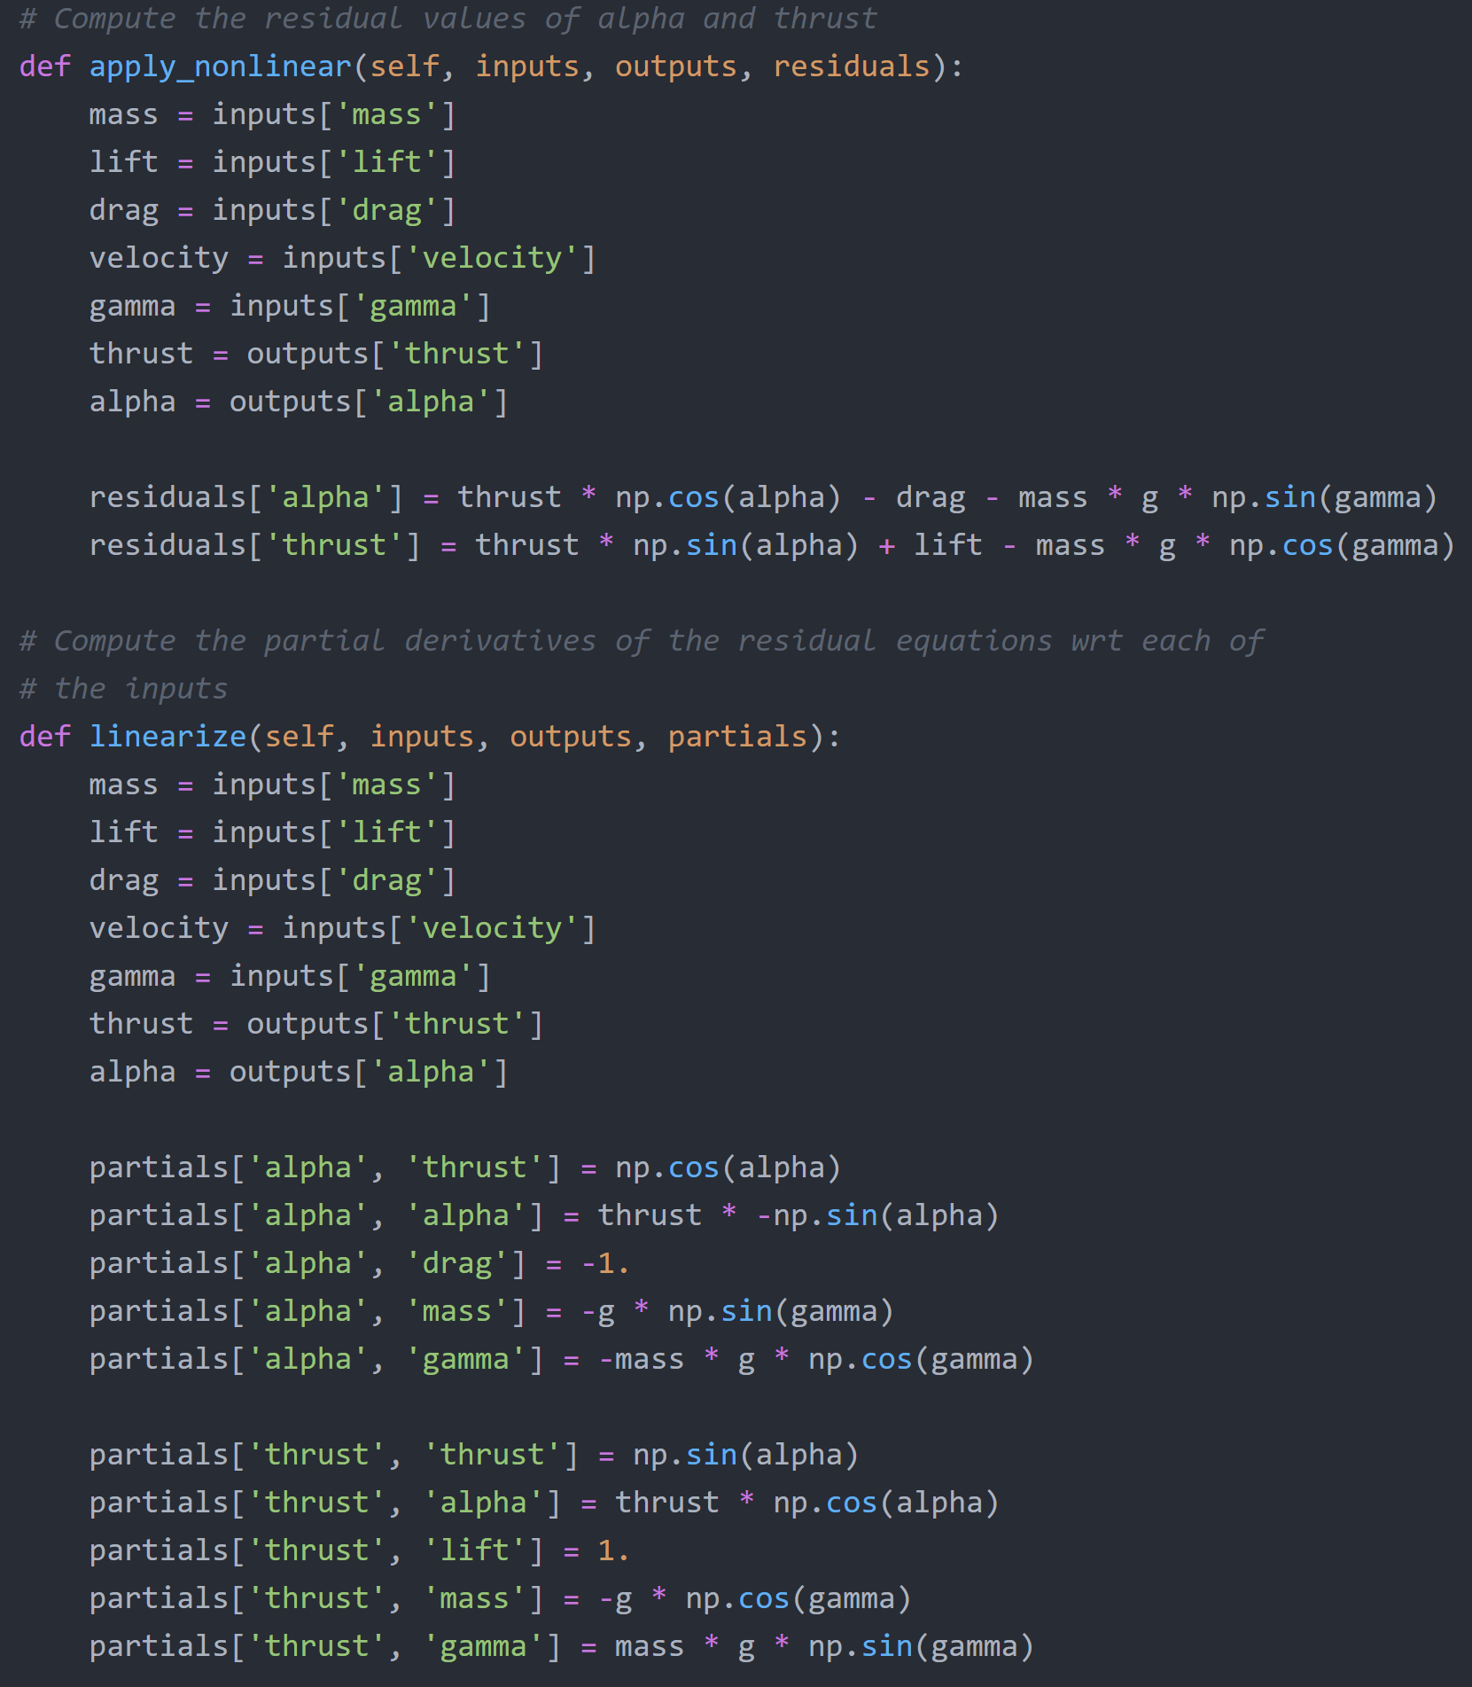
Define residuals, the values we want to drive to 0

Slide 43
Compute partial derivatives of the residuals wrt the inputs

Slide 44
Further code example and explanation

Slide 45
Advanced topics related to obtaining derivatives
Coloring, scaling, etc

Slide 46
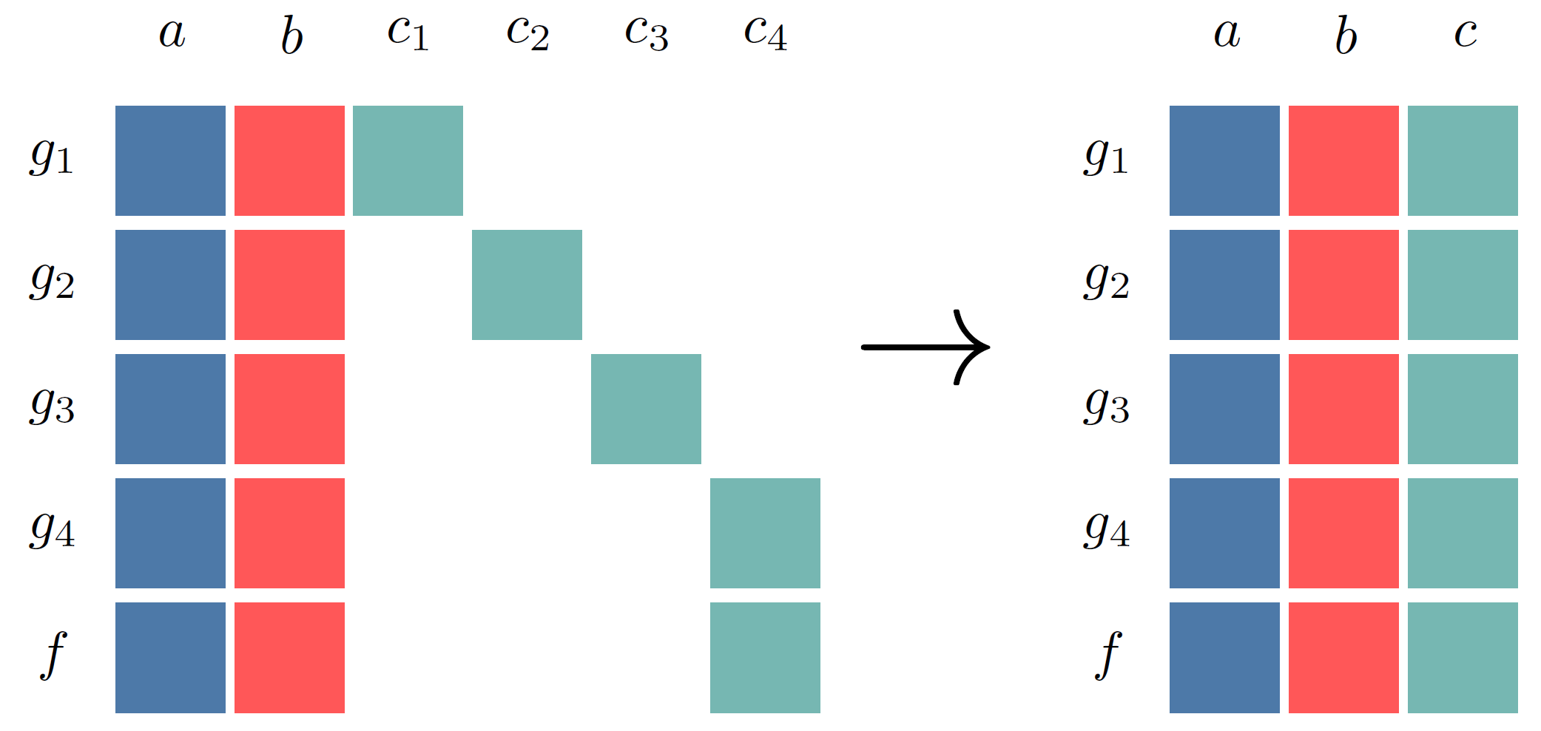
Getting system derivatives efficiently: automatic Jacobian coloring
http://openmdao.org/twodocs/versions/latest/features/core_features/working_with_derivatives/simul_derivs.html

Slide 47
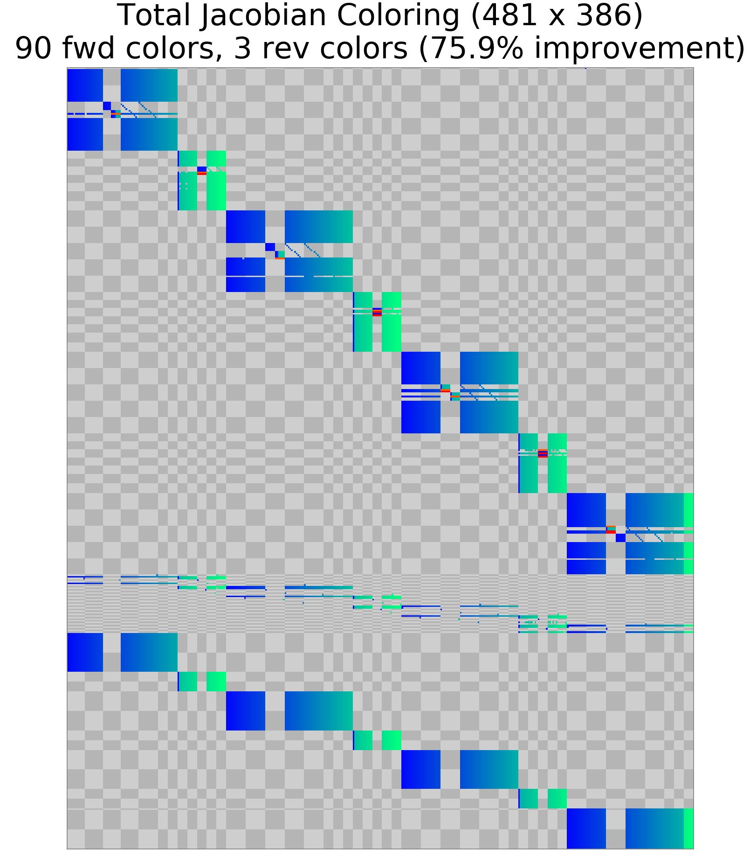
Show coloring examples

Slide 48
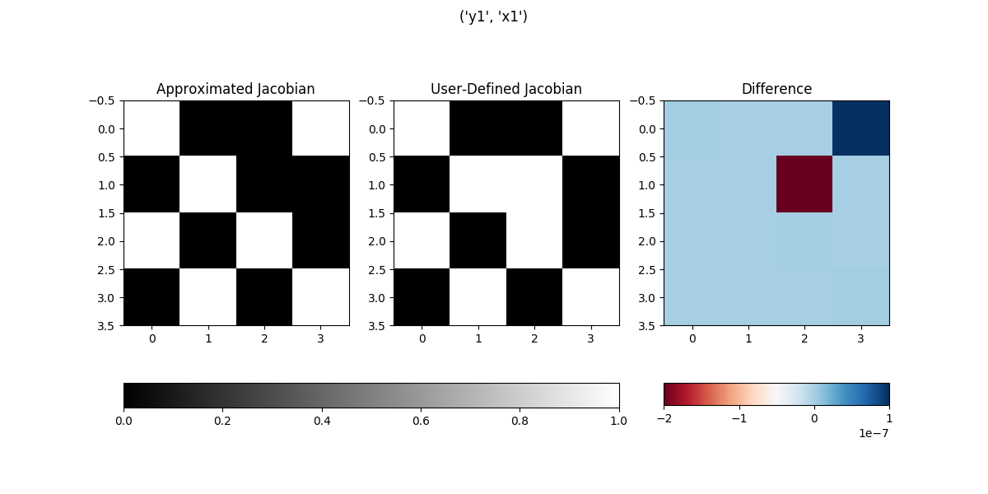
Show coloring examples

Slide 49
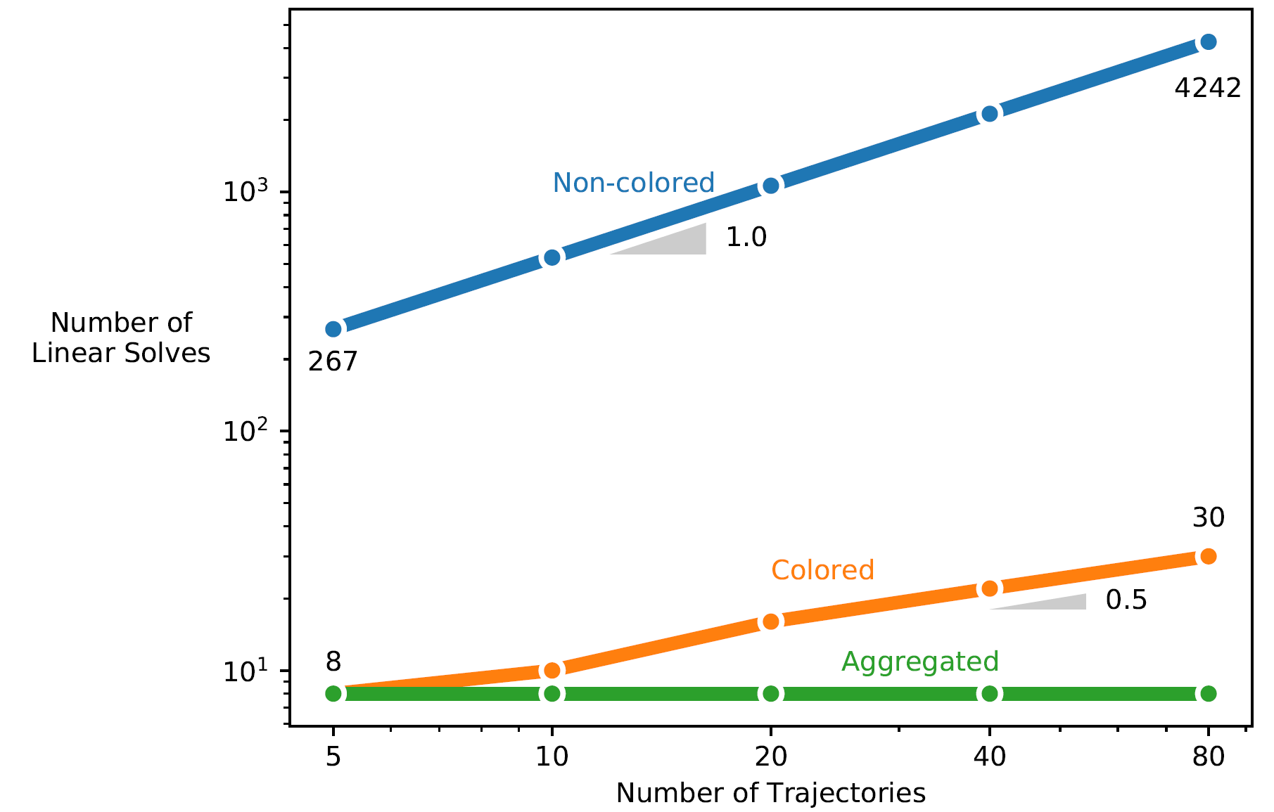
Getting system derivatives efficiently: automatic Jacobian coloring

Slide 50
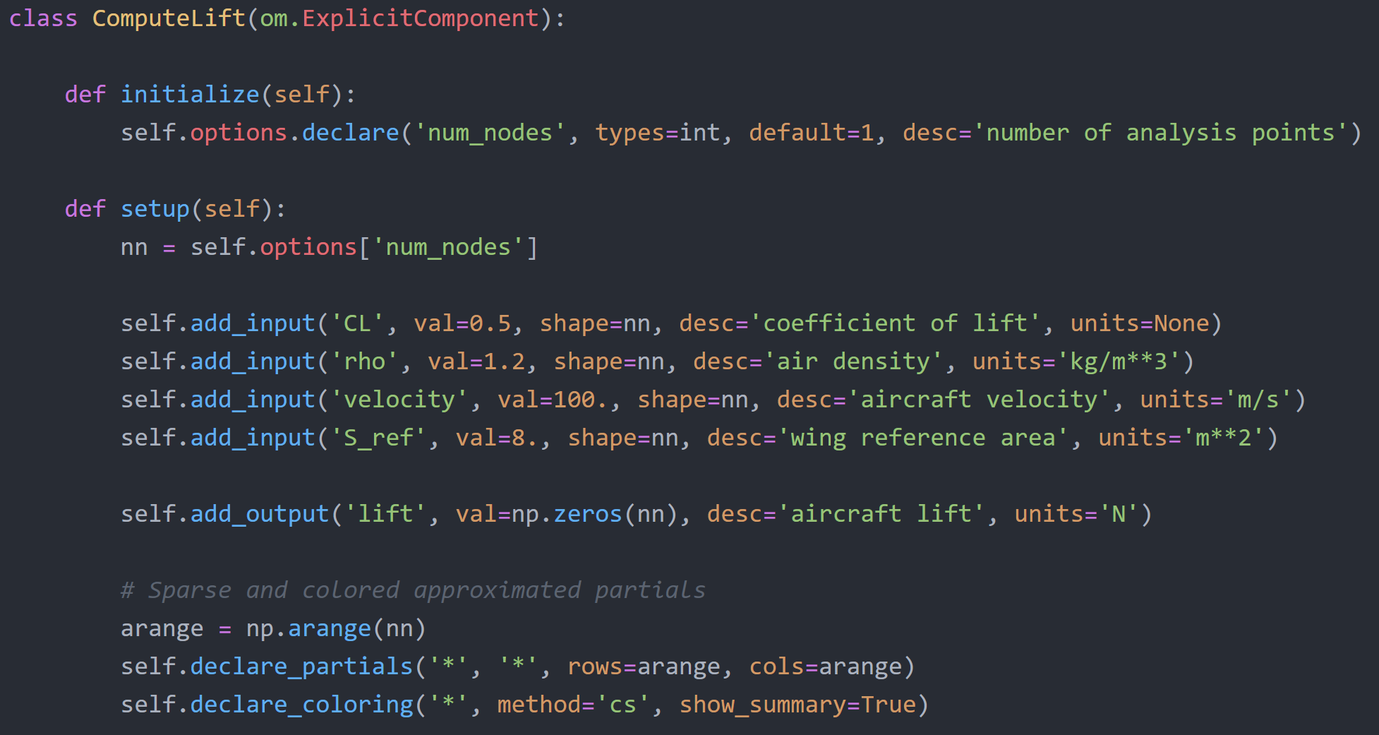
Can use partial derivative coloring to speed up approximation time

